Slide 1
41 International WEBSITE
It‘s your website
Fabian Engler
41 Webmaster

Slide 2
www.41international.net

Slide 3
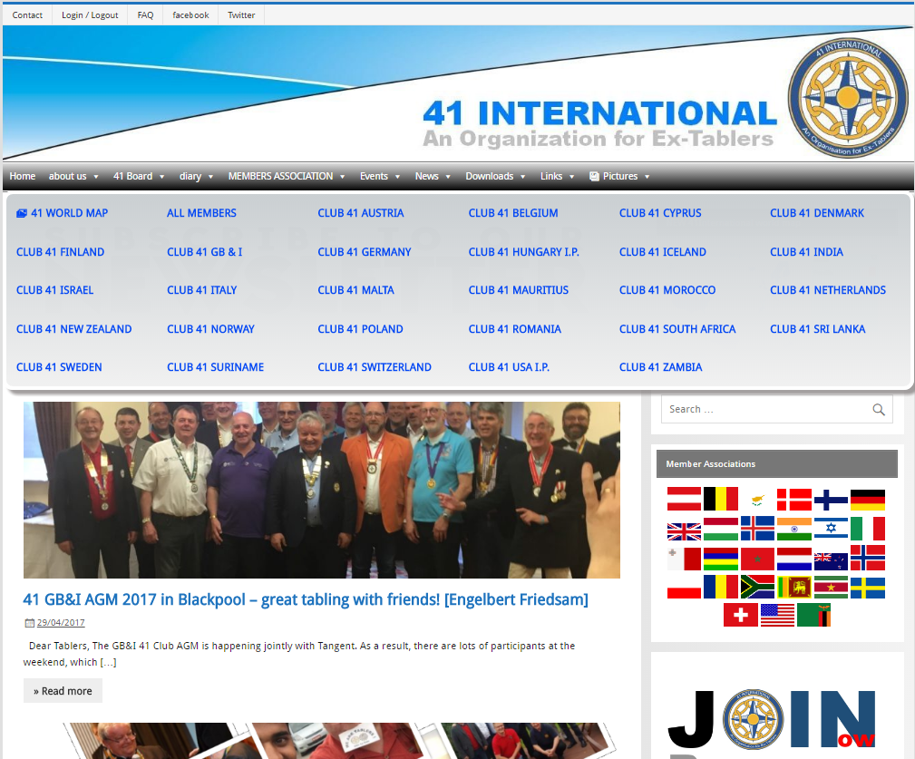
www.41international.net

Slide 4
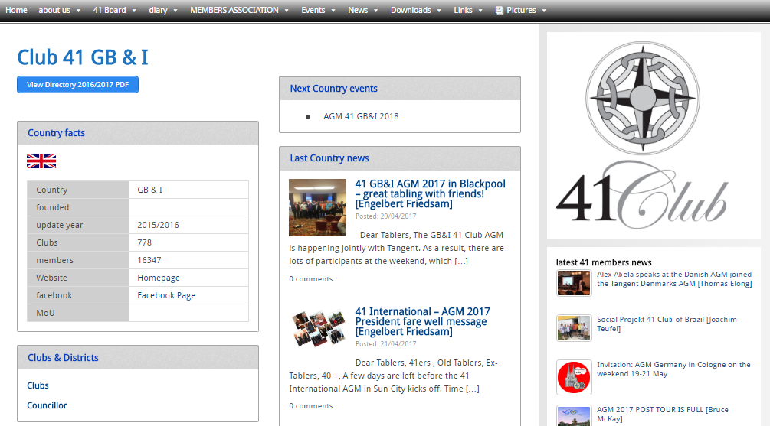
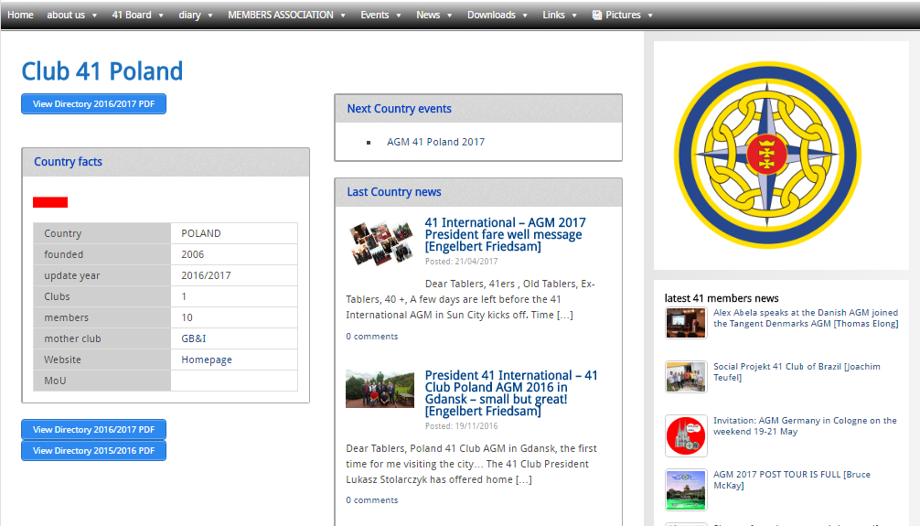
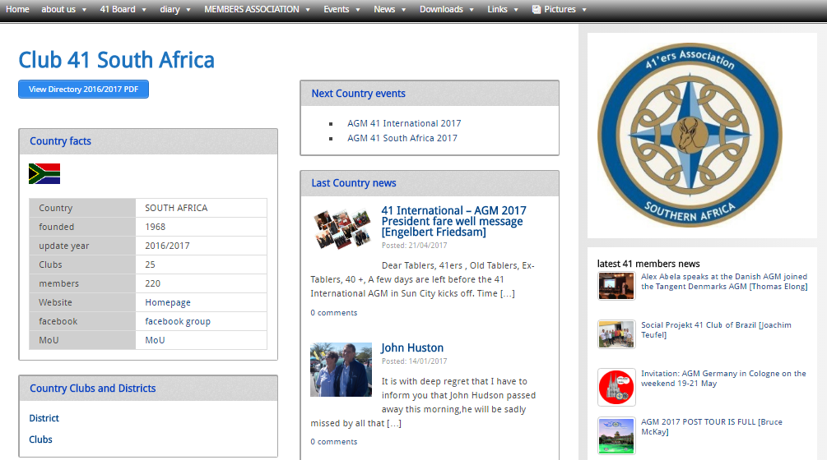
country sites
all about your country!

Slide 5
Your content
automatic distribution

Slide 6
41 homepage statistic 1
over 60.000 visits!

Slide 7
41 homepage statistic 2
grows with your news

Slide 8
41 International at facebook
over 1.000 follower !

Slide 9
41 International at twitter
news pushed at twitter

Slide 10
41 International website newsletter
over 100 subscribers

Slide 11
YAP
www.yap-famex.org

Slide 12
Thank you!
Webmaster@41international.net

