Slide 1
41 international
41st Annual General Meeting
A journey of 41 years of likeminded Tablers / Old Tablers / 41ers

Slide 2
Engelbert Friedsam
41 international
President 2016-2017
Address to the business meeting
A journey of 41 years of likeminded Tablers / Old Tablers / 41ers

Slide 3
41 International VISION PLAN
Future Strategic Direction –
Continuation of what we have initiated
Link to the past - bridge to the future
Relation with Round Table
Improvement
Growth

Slide 4
Work & Achievements 2016 – 2017
Continuation of the Strategic working group. Implementation of our Future Strategic Direction policy.
Continued guidance to all member countries to follow our future direction towards Round Table and how to improve their clubs.
President visit at Round Table International World Meeting in Nepal. Had a joint meeting with Round Table International Board.
Key focus: How can 41ers / Old Tablers help to identify
potential candidates for Round Table?

Slide 5
Work & Achievements 2016 – 2017
Continuation of implementation of MOU from countries by signing their National MOU.
Managed to avoid changing / adjusting our rules☺, instead:
The board has been focusing on extension
How we can help Round Table to grow
How we can line up on Round Table Service Projects.

Slide 6
Work & Achievements 2016 – 2017
Sale of President’s Side-by-Side pins results in a current amount of €7.200 donation to Round Table Italy in agreement of RTI for the RT Italy earthquake charity project. Once more a symbolic act of establishing charity to our Clubs by supporting Round Table charity projects.
Involved with change of YAP organization. Supported the new International YAP Convener Christoph Haenssler. Joined the YAP Tour planning meeting, held in Frankfurt
Continued to promote YAP. All scheduled YAP-Tours went very well, including the 3S YAP program to encourage small countries to participate. Introduced by Makarios and 41 Club Cyprus.

Slide 7
Work & Achievements 2016 – 2017
Continued dialogue with France on the basis of our tabling spirit based on faith in democracy and tolerance. This helps for better understanding and cooperation on both sides.
HYM workshop and discussions have proven to be the way forward in understanding the needs and thoughts of member countries. HYM 2016 workshop was about the harmonization of current names we have in our organization.
Start of the discussion with the challenging goal to harmonize to ONE name.
Second workshop planed to hold at the HYM 2017 in Italy.

Slide 8
Work & Achievements 2016 – 2017
Involved in the International Side By Side charity Project all4nepal with great results of our investments to rebuild schools. Visited 3 schools that have been built from the all4Nepal donations, where more than 1000 children now get education again.
Attended the departure of the 2016 “Weihnachtspäckchen” Convoy at Hanau, Germany. Great example what can be achieved when the Round Table family works together!
First year of new Editor. Combination of content Hinge and Communiqué into a new monthly extended News Letter. Bravo Sid☺!!

Slide 9
Work & Achievements 2016 – 2017
Focused on having a lively new web platform with up to date content. Bravo Fabian ☺!
Publications of articles in our means of communications and related family Organizations.
Started the President Diary on the 41 International website. Entered 30+ messages / reports to inform about the visits and activities during the year.

Slide 10
Work & Achievements 2016 – 2017
We visited 23 Countries.
President had a meeting with the Board members of the member countries during their AGM. Exchange of activities and ideas has been always welcome.
Extension: Hungary, Portugal and USA have submitted their application to become member of 41 international. Expected to be affiliated at next year’s AGM in Austria.
Continued having close relations with all related Round Table Family Clubs.

Slide 11
Work & Achievements 2016 – 2017
Team work with the Board - 3 Board meetings.
Comradery and fellowship among members has continued to improve through activities between member countries like the “Alpenboard Meeting” (Italy, Austria, Switzerland, Germany).
Introduced a discussion platform by holding workshops at the HYM.
Maintained and strengthened the bond of International friendship which unites all Tablers and Ex- Tablers.
Worked Side by Side with Round Table

Slide 12
We put our best effort and had as guidance our roots and key values of Round Table and carried out the 41 International Ideals & principles
Thank you all for your help, support and contribution☺!
A journey of 41 years of likeminded Tablers / Old Tablers / 41ers

Slide 13
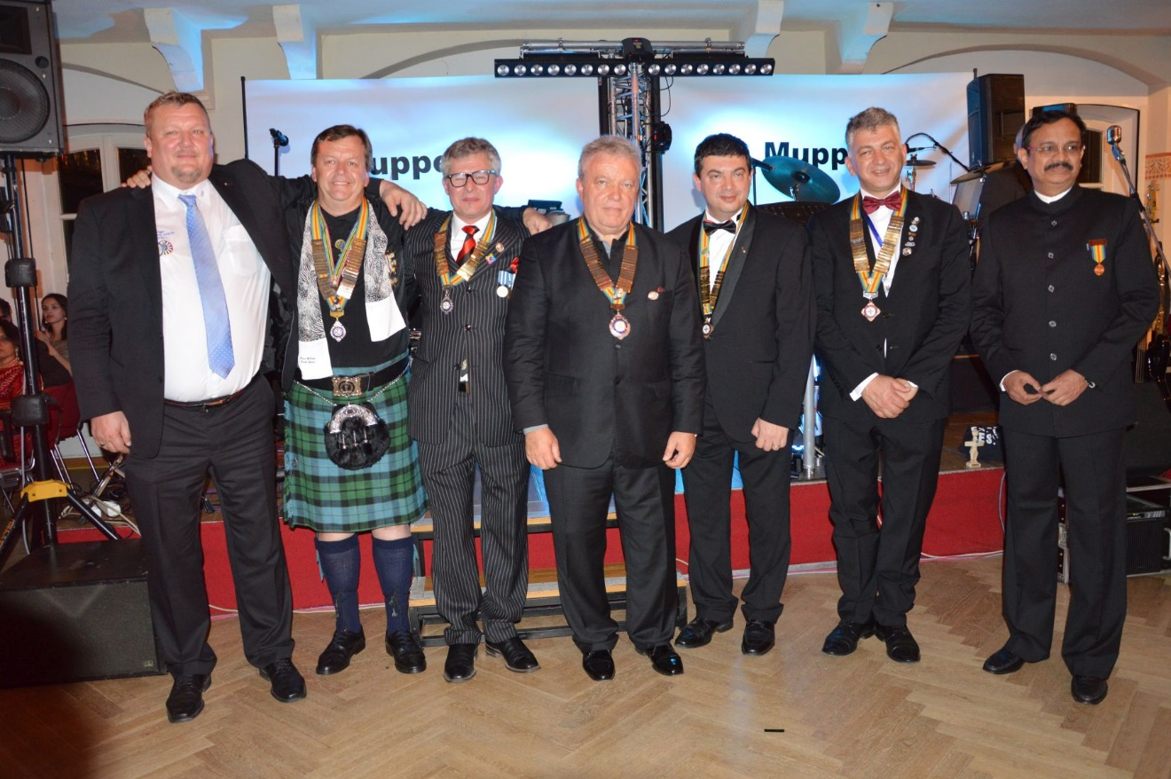
Work & Achievements 2016 – 2017
Board Team 2016-2017

Slide 14
I am deeply humbled and at the same time extremely honored and very proud to have served you as your President 2016-2017 and thank you for giving me the opportunity to feel and experience your welcome wherever I went. This year has enriched my live so unbelievably much!!
Thank You ☺!!
Engelbert Friedsam
President 2016 – 2017
WE ARE TABLERS ☺!!!!!!!!!! One Time A Tabler – Always A Tabler!

