Slide 1
41ers Club of New York

Slide 2
Who we are
Ex Tablers from RT1NY
Probably the only club in the world with maximum diversity ( Seven countries)
14 Members and expected to grow
Chartered in Jan 2015
Meet once in a month New York

Slide 3
Board
Jagannath Bachu ,President
Mark Van Ophem ,Vice President
Martein Johannsen, Secretary
Francis Verpoucke ,Teasurer

Slide 4
Current Members and their Origin
1.Jagannath Bachu (India)
2.Mark Van Ophem ( Dutch)
3.Harmen Vander Linde (Dutch)
4.Francis Verpoucke (Belgium)
5.Lalit Khanna (India)
6.Michael Nagakary (American)
7.Martein Johannssen ( Iceland)
8. Mesut Celebi (Dutch)
9.Lieven Nutyens (Belgium)
10.Dan Filipescu ( Romania)
11.Ajay Puri ( India)
12.Jan Dkempe (Belgium)
Notes:
Contd.

Slide 5
Contd..
13.Leigh Beckett (Dutch)
14.Gaby Hasson ( Isarael)
15. Dezo Bodis ( Romania)

Slide 6
Business Agenda ,& future plan
Meet once a month for beer
No specific agenda but to meet for fun
Annual Ski trip in feb
Discuss current and future state of USA (under Trump)
Create website for the club with all the information of members & pins

Slide 7
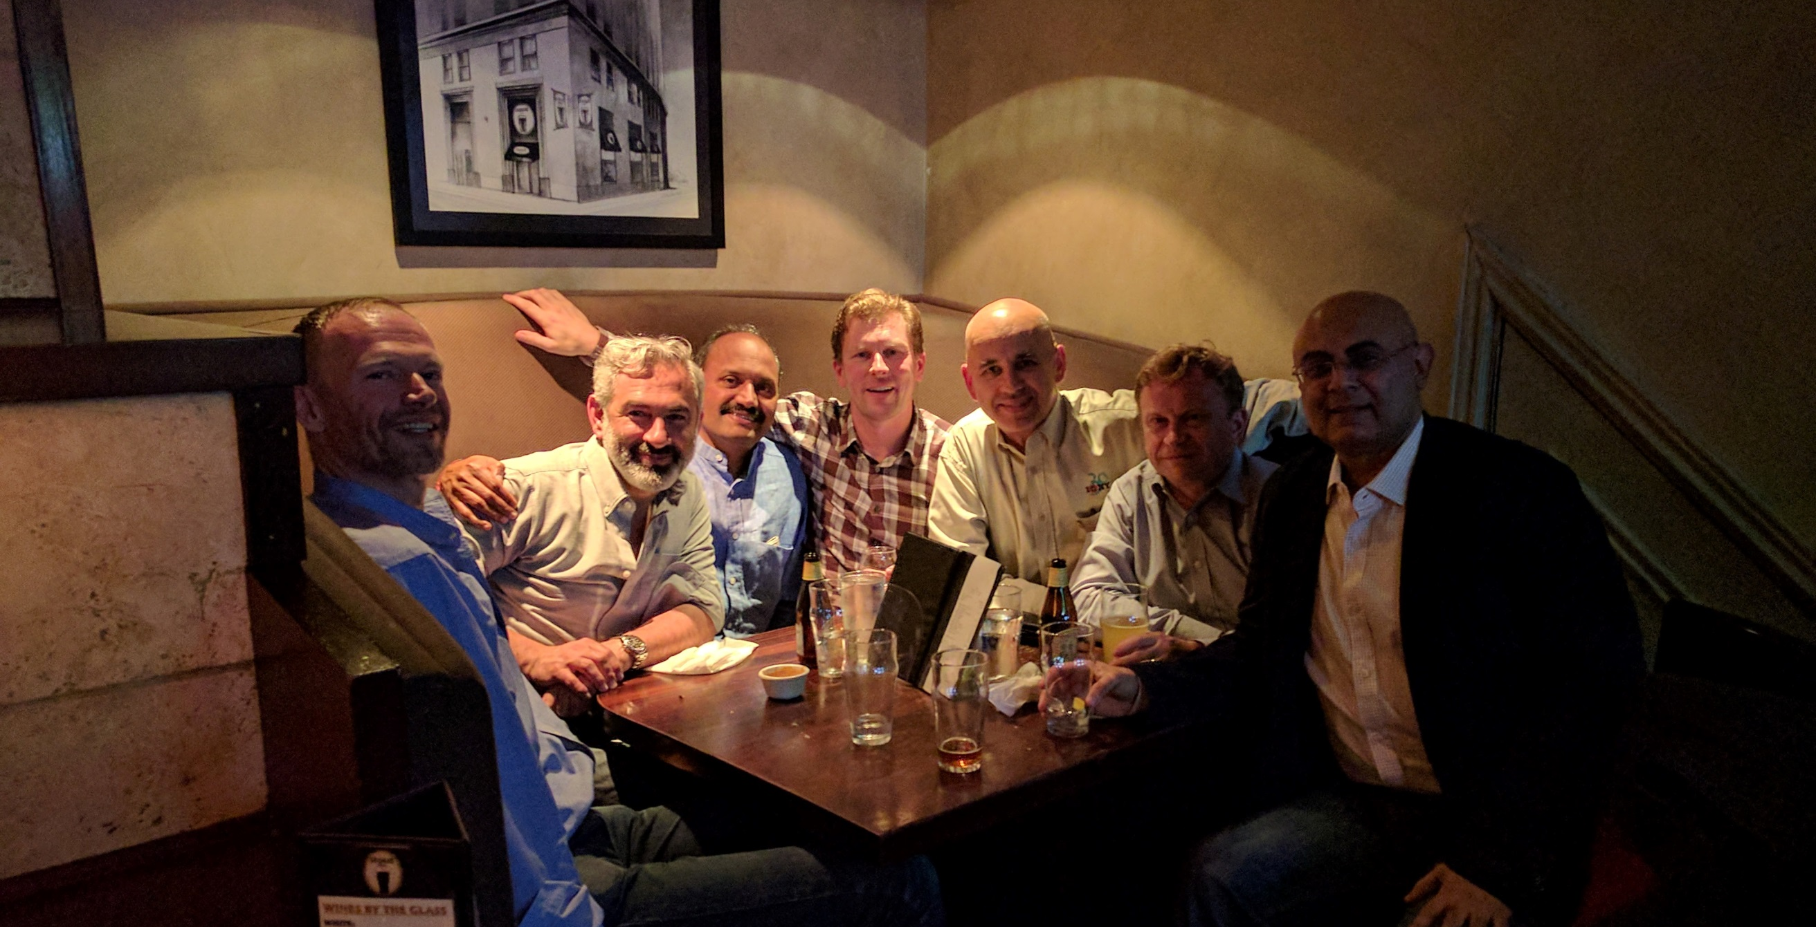

Slide 8
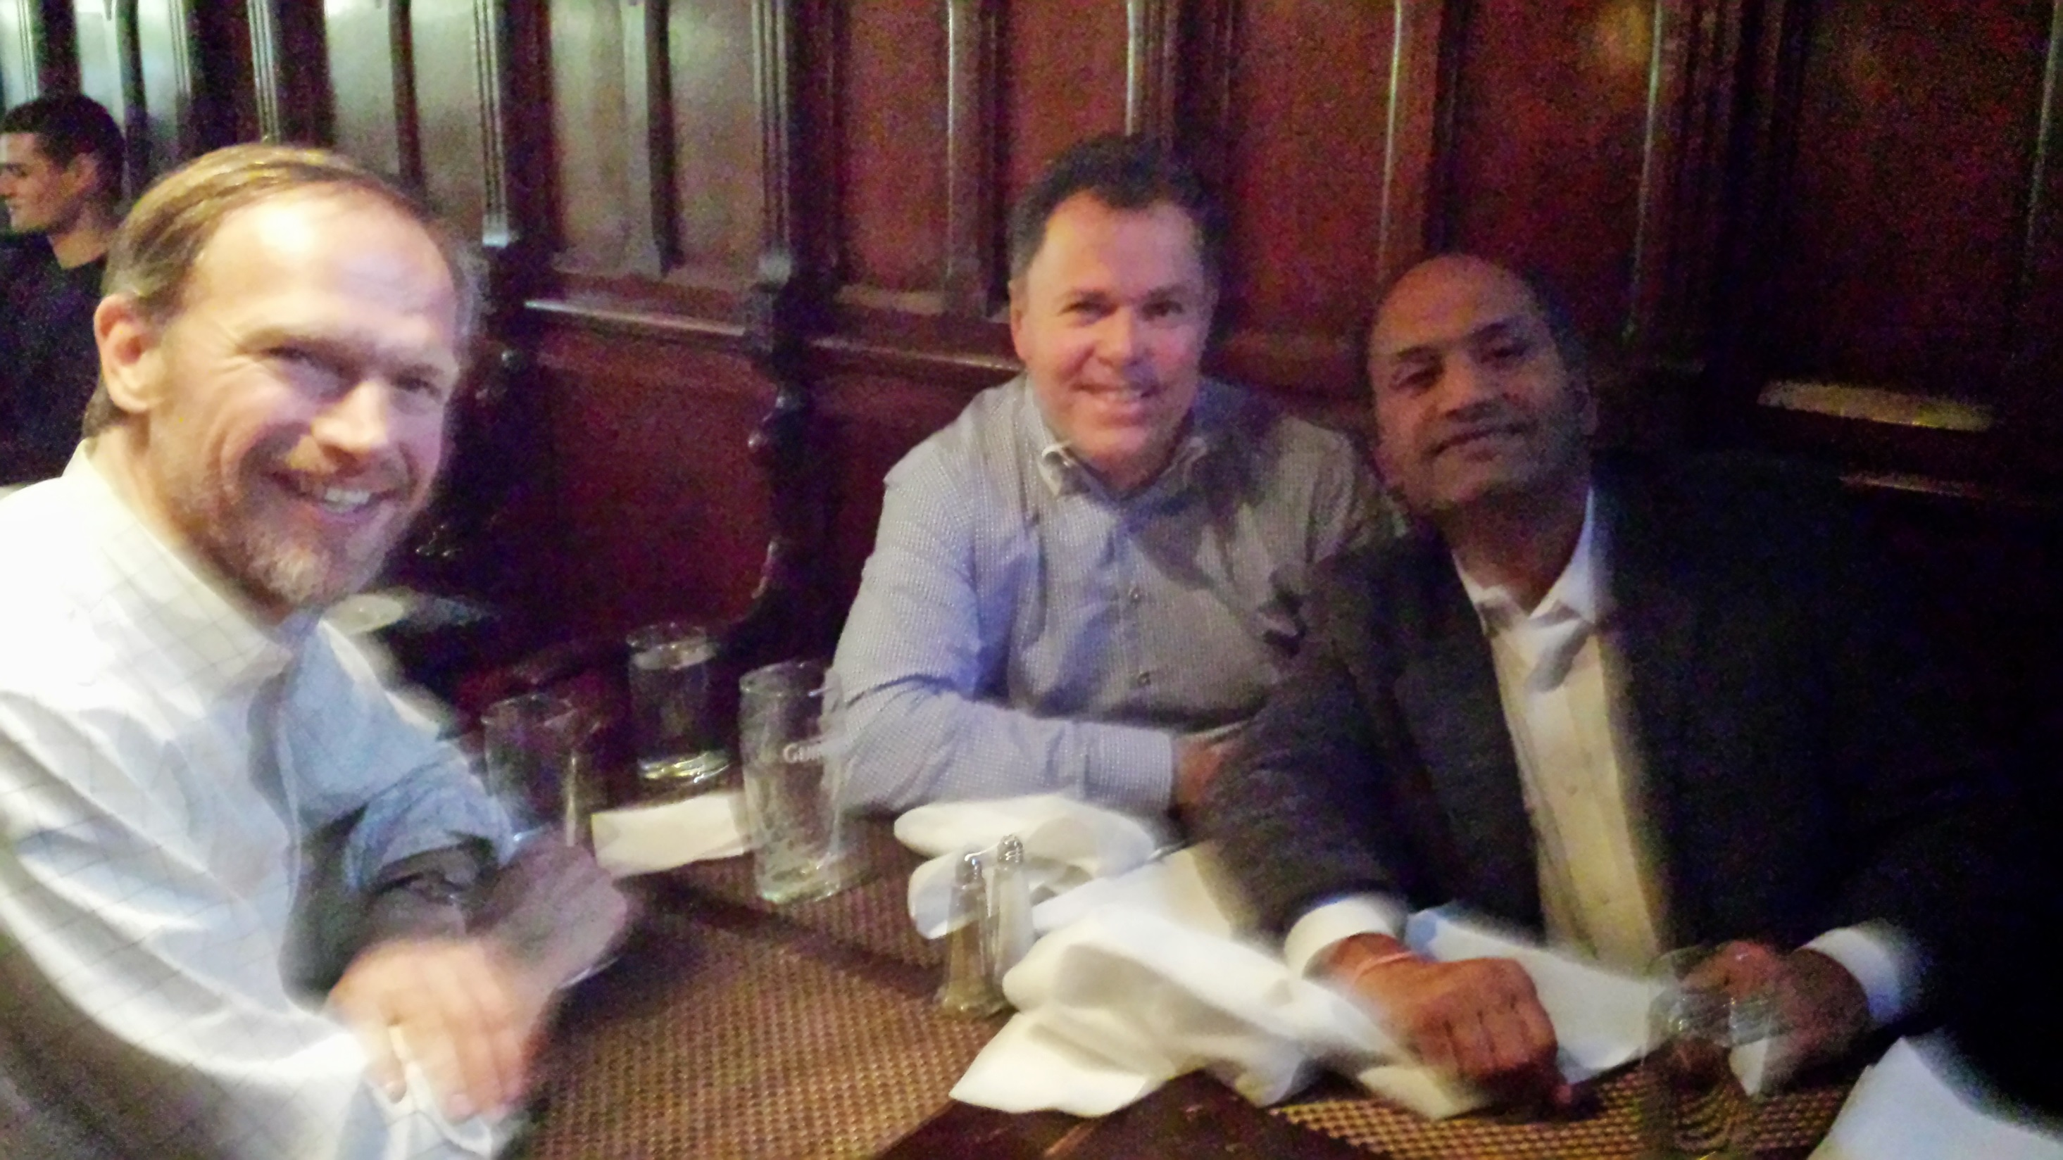

Slide 9
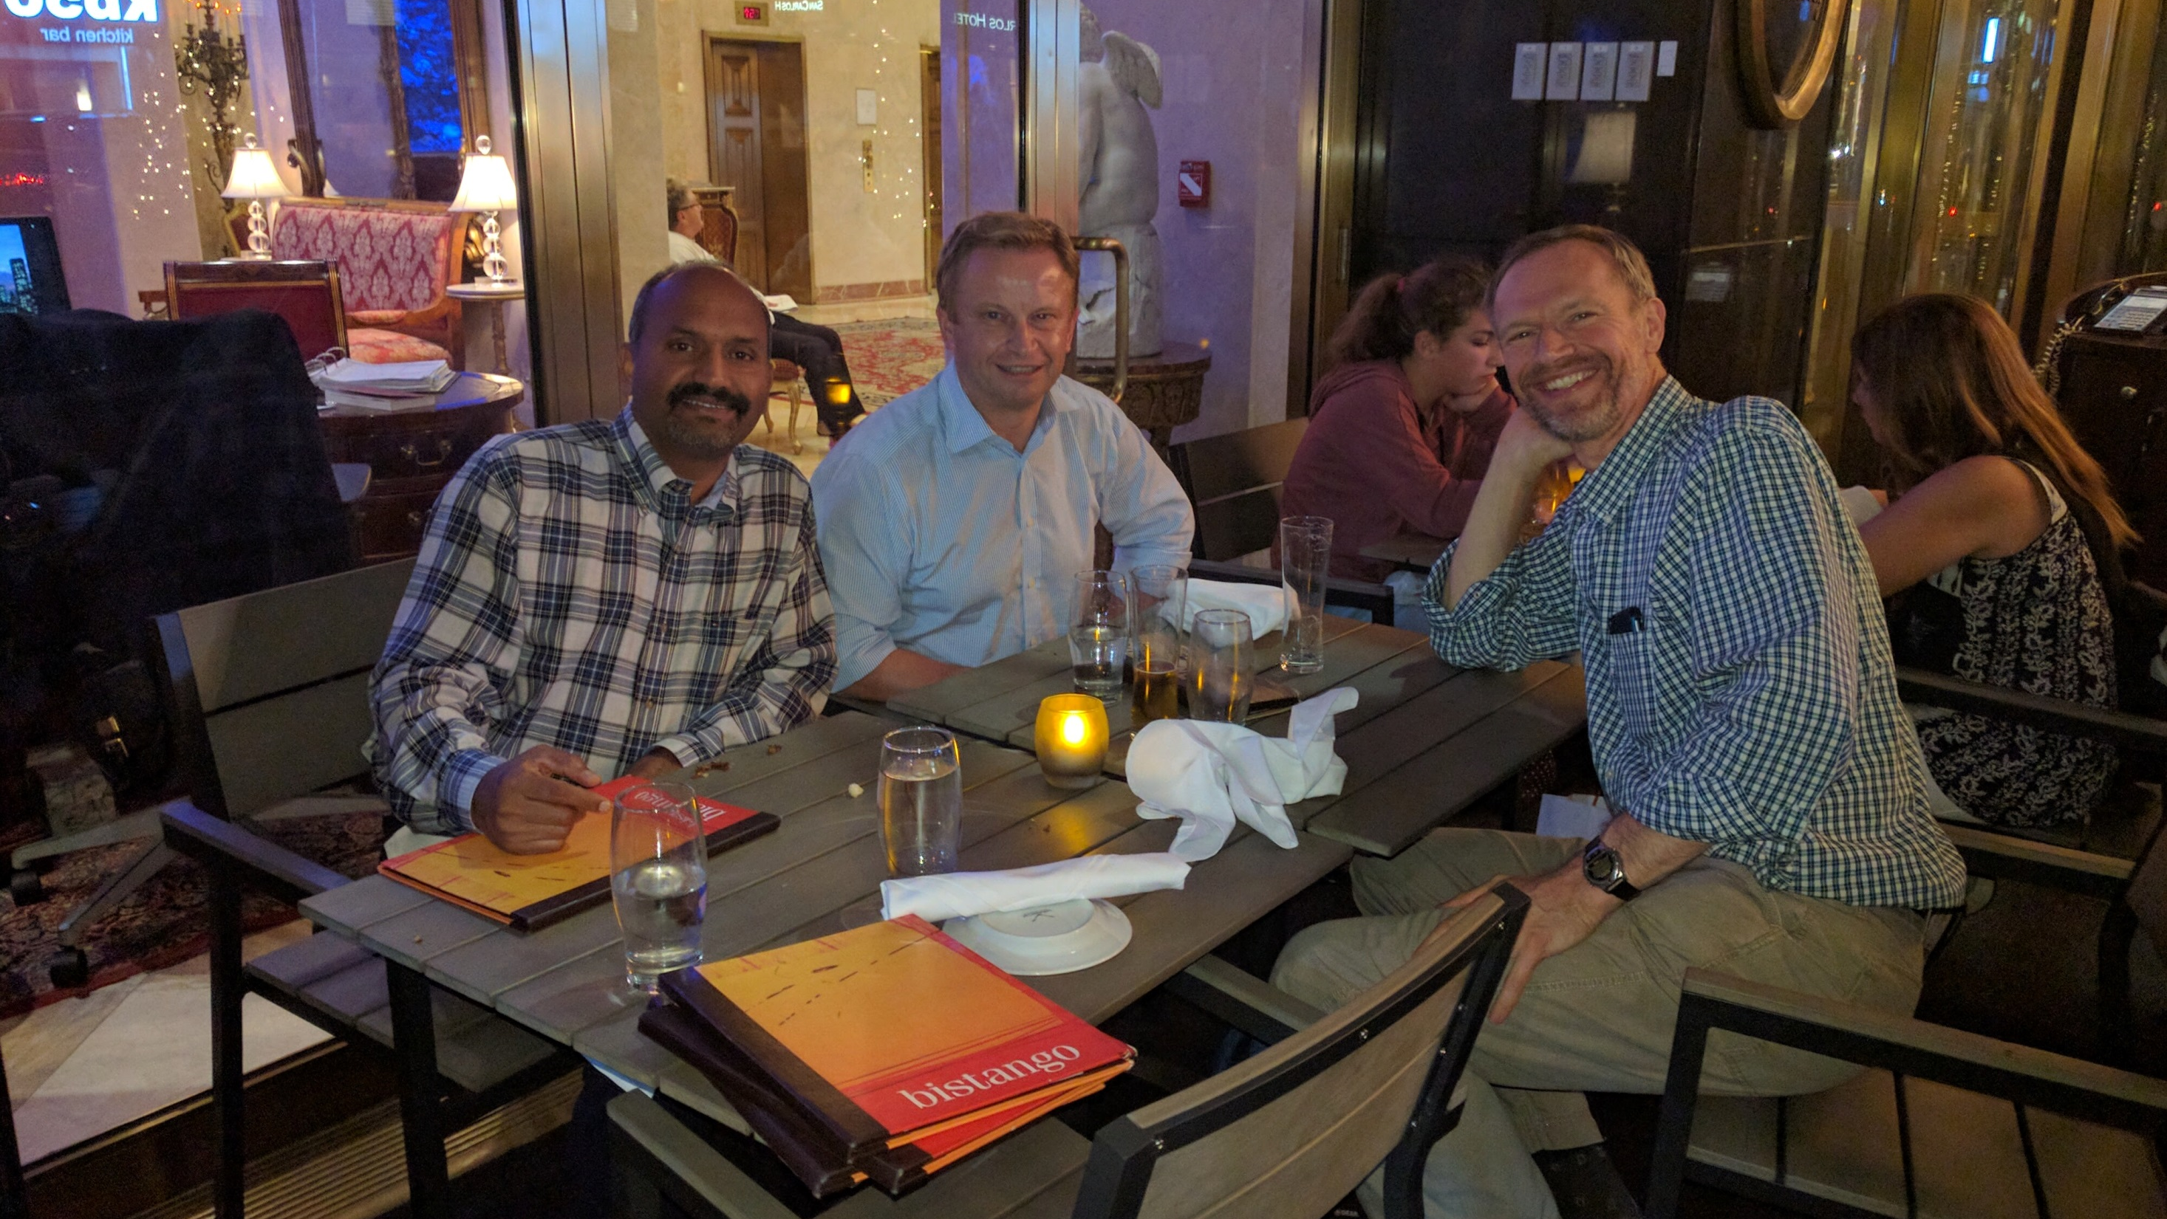

Slide 10
