Slide 1
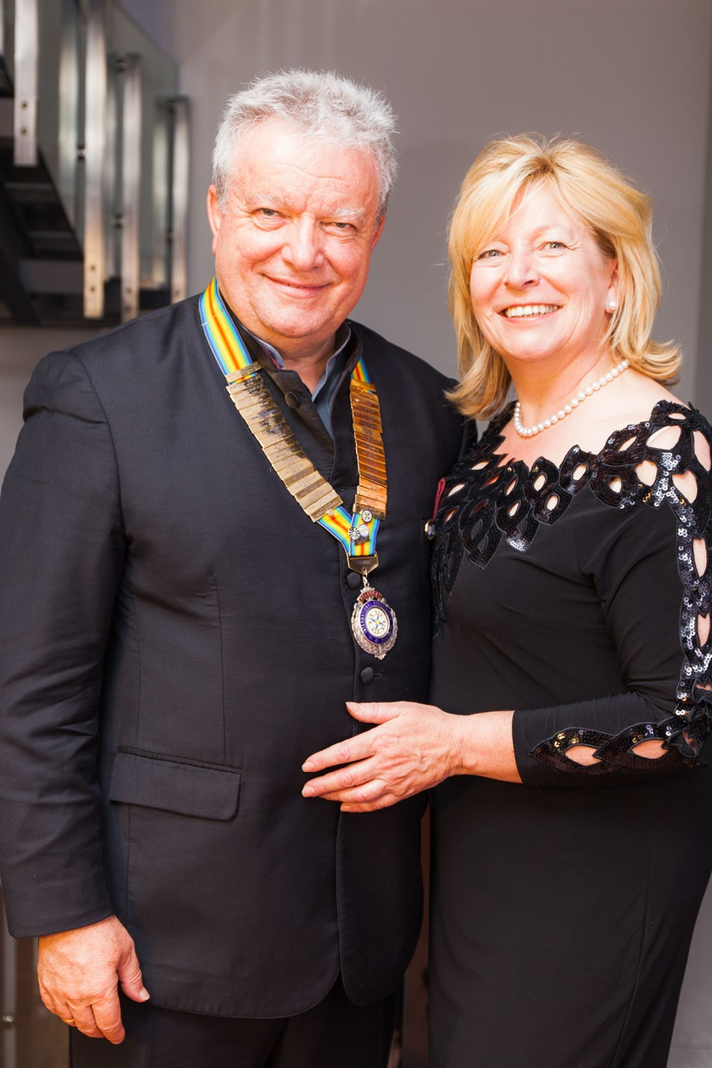
Engelbert Friedsam
President 2016/2017

Slide 2
AGM 2016 Ex-Tablers Denmark

Slide 4
AGM Old Tablers Sweden

Slide 6
AGM Italy

Slide 8
AGM Germany
All members of OT74 Hanau

Slide 10
AGM 41 Netherland

Slide 12
AGM 41 Club Austria

Slide 14
AGM Cyprus

Slide 16
AGM Suriname

Slide 18
President’s visit all4nepal school project

Slide 19
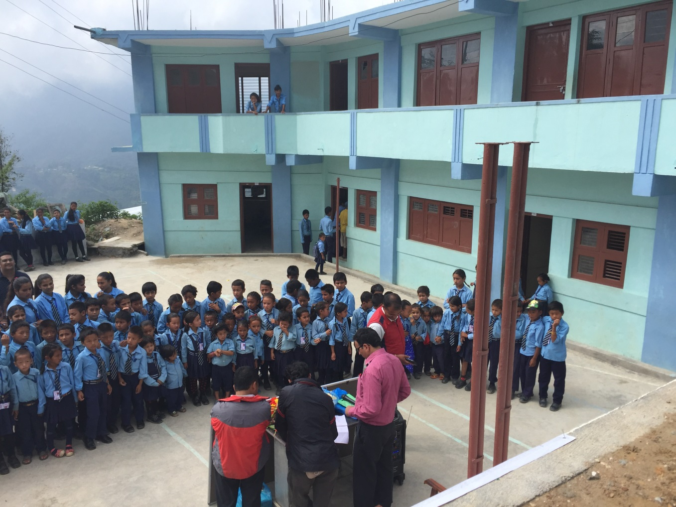
President’s visit all4nepal school project

Slide 21
RTI AGM In Kathmandu

Slide 23
AGM 41 Club South Africa

Slide 25
AGM 41 Club Morocco 2016 and Charter of 41 Club 6 Marrakech

Slide 27
41 Club Belgium AGM 2016 in Eupen

Slide 29
41 Club Poland AGM 2016 in Gdansk – small but great!

Slide 31
41 International 2016 HYM at Bangalore / India

Slide 33
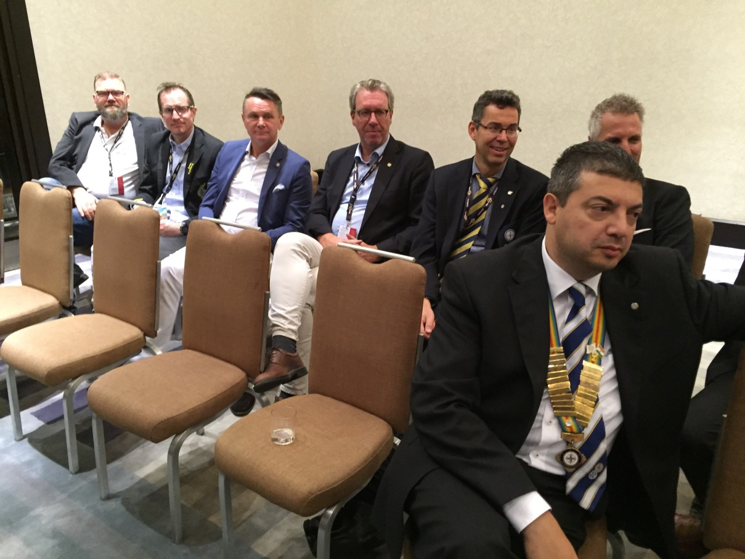
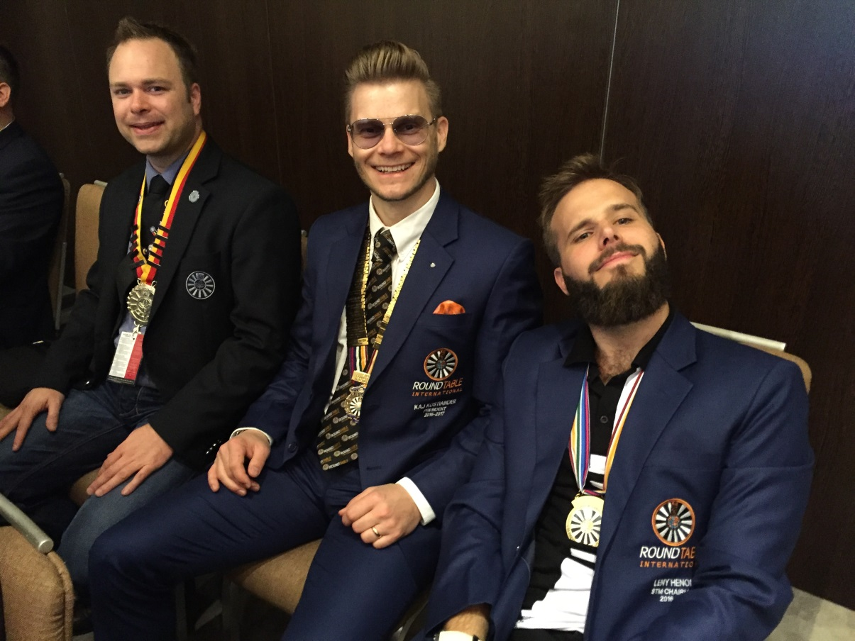
AGM Malta

Slide 35
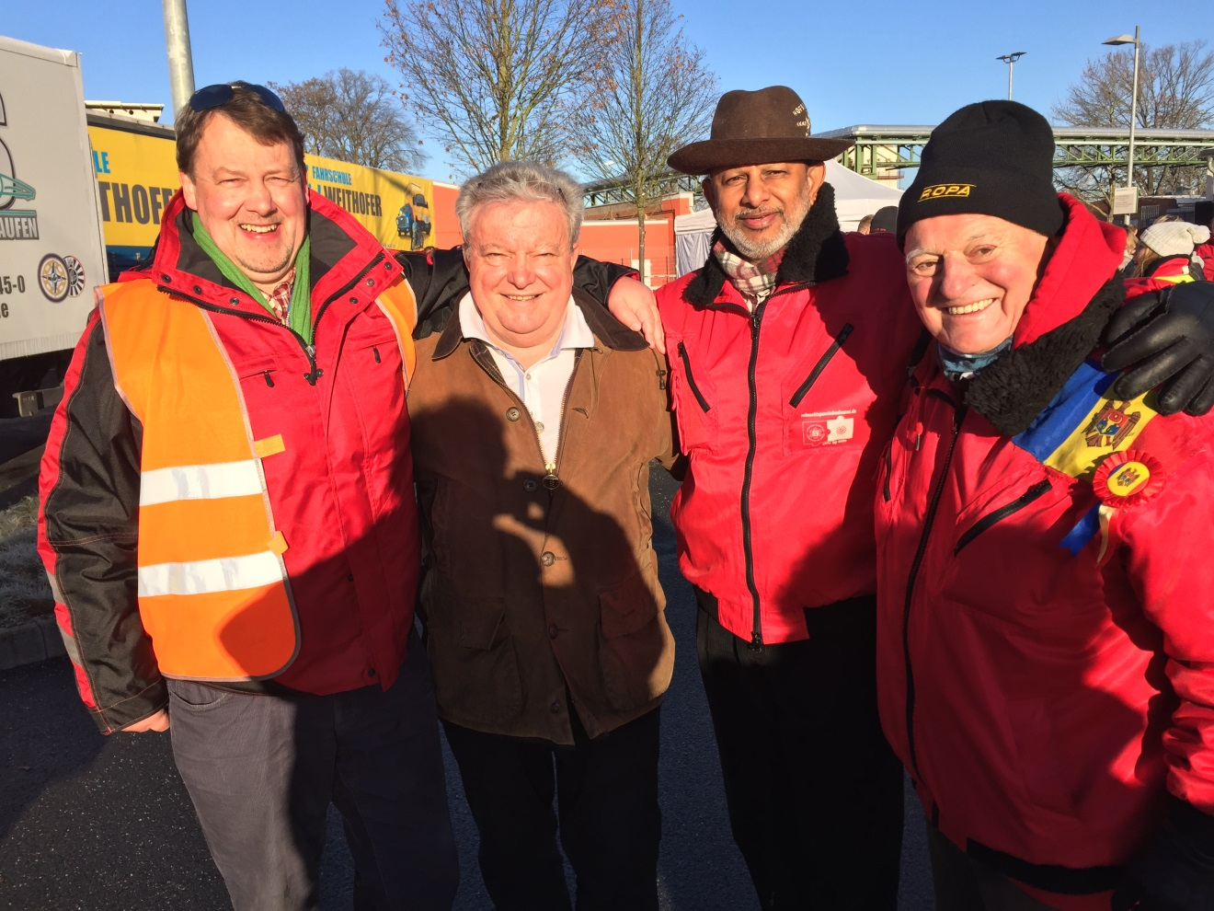
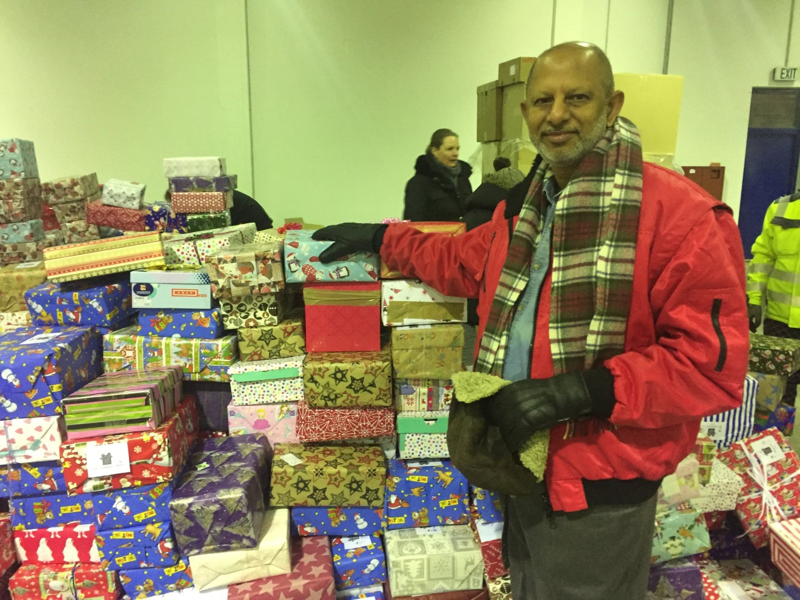
Departure christmas parcel convoi

Slide 37
Boardmeeting in Portugal visit 41 Club Porto

Slide 39
AGM Old Tablers Finland 2017

Slide 41
AGM 41 GB&I 2017 in Blackpool

Slide 43
Thank you!

